Slide 1



By – Saurabh Jain
i-Learn | a T&D initiative

Slide 2

Agenda
Quick Recap
What is Hadoop ?
Hadoop Core Components.
HDFS
MapReduce framework
Example 1 – WordCount
Create Hadoop Project
How to write a Mapper ?
How to write a Reducer ?
How to write a Driver ?
Example 2 - FBMutualFriendsFinder
i-Learn | a T&D initiative

Slide 3
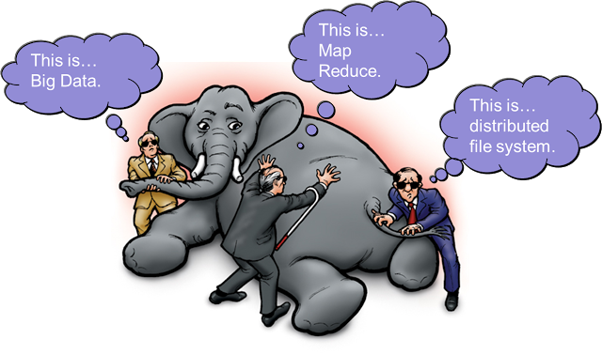
What is Hadoop ?
i-Learn | a T&D initiative

Slide 4

What is Hadoop ?
Apache Hadoop is an open source framework that allows storage and processing in a distributed fashion using cheap commodity hardware.
Completely written in Java.
Named after his son's toy elephant
i-Learn | a T&D initiative

Slide 5
Hadoop Core Components
HDFS – Hadoop Distributed File System (Storage)
MapReduce Software Framework (Processing)
i-Learn | a T&D initiative

Slide 6
HDFS Overview
Based on Google File System.
A distributed , scalable and highly available file system.
Strores large files (GB,TB) across multiple machine in the cluster.
Master Slave Architecture
i-Learn | a T&D initiative

Slide 7
HDFS Architecture
Operates on top of existing file system.
Files are stored as blocks.
Data reliability through replication.
Master Slave Architecture.
Namenode stores metadata and datanode stores actual data.
i-Learn | a T&D initiative

Slide 8
HDFS Commands
Have similar type of shell commands that we have used with any *nix based file system.
i-Learn | a T&D initiative

Slide 9
MapReduce
Based on Google MapReduce.
A framework that can process huge amount of data in parallel on large clusters.
Each node process data stored on it.
Everything in MR is handled as key-value pairs.
Can write in Java,Python,C++ (Pipes),Perl etc
Each Job is divided into 3 phases.
  Map Phase
  Shuffle and Sort
  Reduce Phase
i-Learn | a T&D initiative

Slide 10
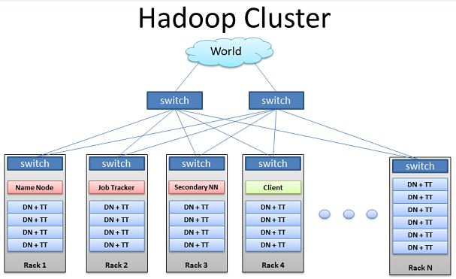
Hadoop Cluster
i-Learn | a T&D initiative

Slide 11
Example - WordCount
Count the occurence of each word in a file.
How our input file looks ?
What should be our output file ?
Flow Diagram
Lets Code.
Build and Execute.
i-Learn | a T&D initiative

Slide 12
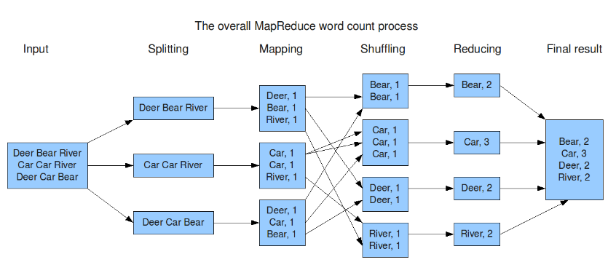
WordCount FlowDiagram
i-Learn | a T&D initiative

Slide 13
Create Hadoop Project
Create a Java project using IDE of your choice.
Maven/Ant/Gradle or any other build tool can also be used.
Add the required dependencies or jars.
Configure project to make it as an executable jar file.
i-Learn | a T&D initiative

Slide 14
How to write a Mapper ?
Identify key-value data types as per your input file.
Every mapper in MR application is a child of org.apache.hadoop.mapreduce.Mapper class.
Override the map function with your business logic.
Write the output key-value pair to the context.
i-Learn | a T&D initiative

Slide 15
How to write a Reducer ?
Identify key-value data types for your final output.
Every reducer in MR application is a child of org.apache.hadoop.mapreduce.Reducer class.
Override the reduce function and write your business logic in it.
Write the final output key-value pair to the context.
i-Learn | a T&D initiative

Slide 16
How to write a Driver ?
Should implement Tool interface and be a child of Configured.
Implement run() method.
Create the Job object.
Add the input and output file location.
Set the Mapper and Reducer class.
Set the key-value datatype.
Set the input format class.
i-Learn | a T&D initiative

Slide 17
Build and Execute
Bundle the project as an executable jar file.
Run the command.
$ hadoop jar <jar_file_name> <driver_classs_name> <Input_file_location> <output_file_location>
i-Learn | a T&D initiative

Slide 18
Example - FBMutualFriends
Find the mutual friends between 2 friends.
How our input file looks ?
What should be our output file ?
Flow Diagram
Lets Code.
Build and Execute.
i-Learn | a T&D initiative

Slide 19
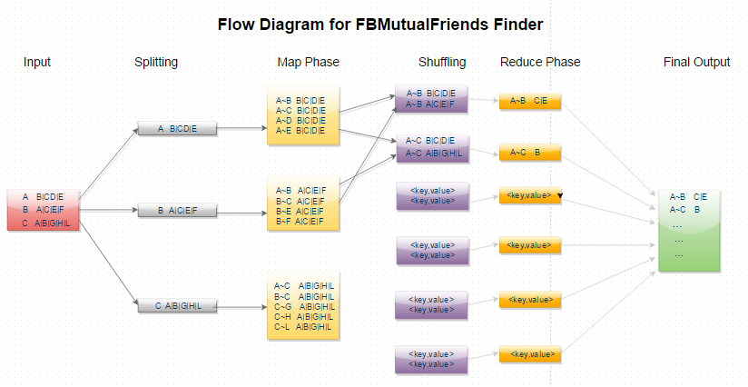
FBMutualFriends FlowDiagram
i-Learn | a T&D initiative

Slide 20
Exercise 1 – Word Count V2
Find all the words having length from 1 to N.
How our input file looks ?
What should be our output file ?
Lets Code.
Build and Execute.
i-Learn | a T&D initiative

Slide 21
Exercise 2 – Correlation Coefficient
Calculate correlation coefficient for all the similar items present in the input file.
How our input file looks ?
What should be our output file ?
Lets Code.
Build and Execute.
i-Learn | a T&D initiative

Slide 22
References & Source Code
Source code -
https://github.com/jsaurav/Hadoop-Examples
Getting Started -
https://developer.yahoo.com/hadoop/tutorial/
Hadoop Definitive Guide – Tom White
i-Learn | a T&D initiative

Slide 23

Q & A
i-Learn | a T&D initiative

